Slide 1
Convolutional Neural Networks
Introduction to python
THURSDAY February 25, 2021
Marcia Hon

Slide 2
Outline
What is a Neural Network and Deep Learning
What is a Convolutional Neural Network
Alzheimer’s Diagnosis

Slide 3
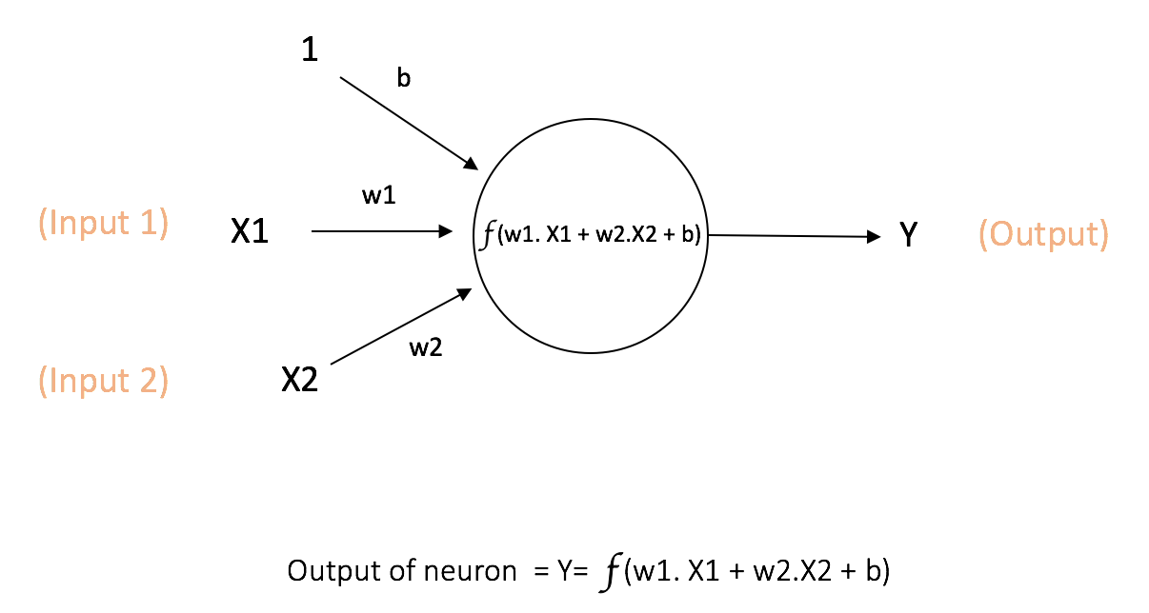
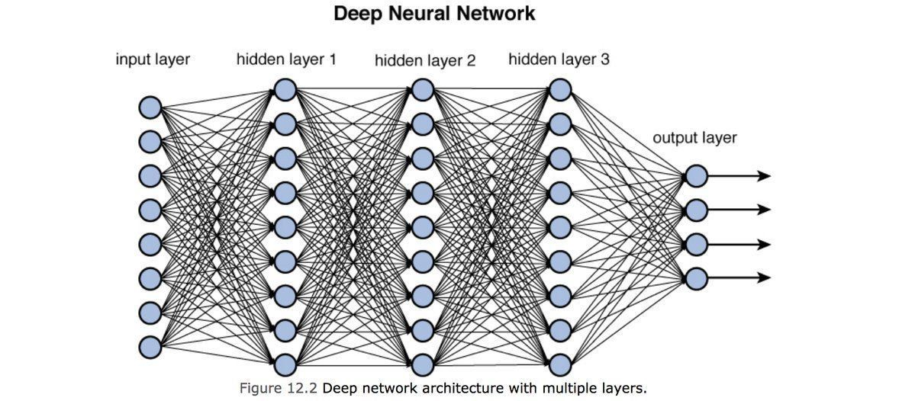
Neural Network and Deep Learning
Neuron
Deep Learning

Slide 4
Deep Learning Training
Optimizer for gradient decent (how fast reaches minimum)
Loss Function (difference between predicted and target)
Function to determine how accurate are the predictions
* Based on these three that are done at every training session, our Deep Learning model is trained

Slide 5
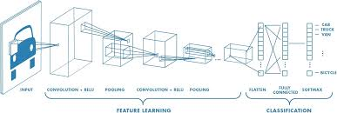
Convolutional Neural Network - Imaging

Slide 6

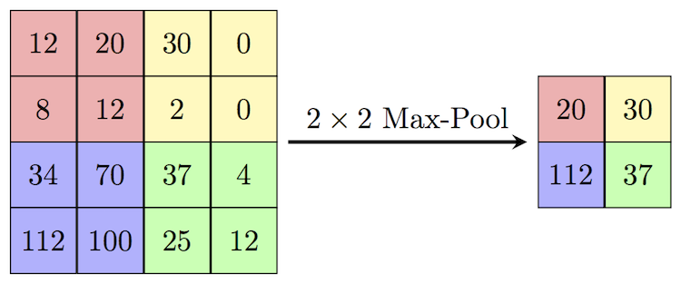
Convolutional and Max Pooling Layers

Slide 7
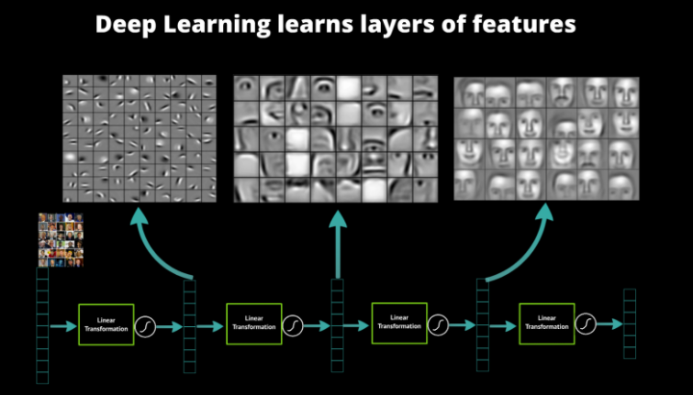
Feature Learning with Convolutional Layers

Slide 8
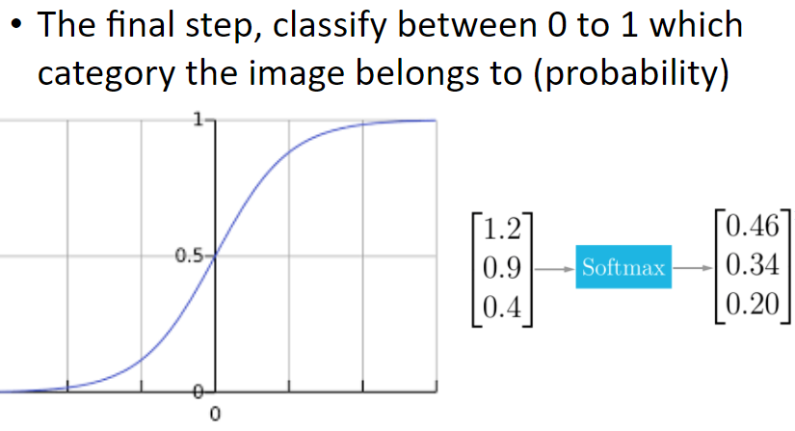
Final Layer

Slide 9
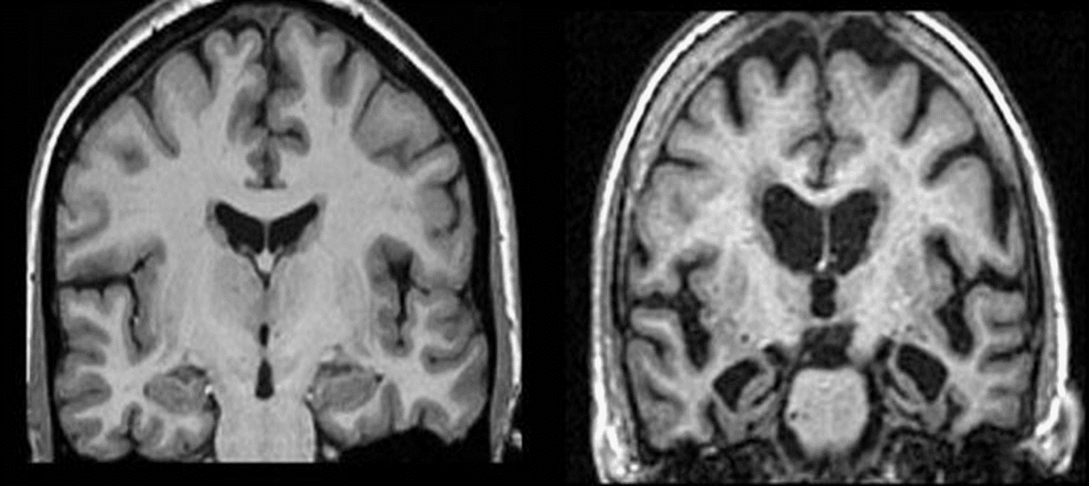
Alzheimer’s Diagnosis
What is Alzheimer’s

Slide 10
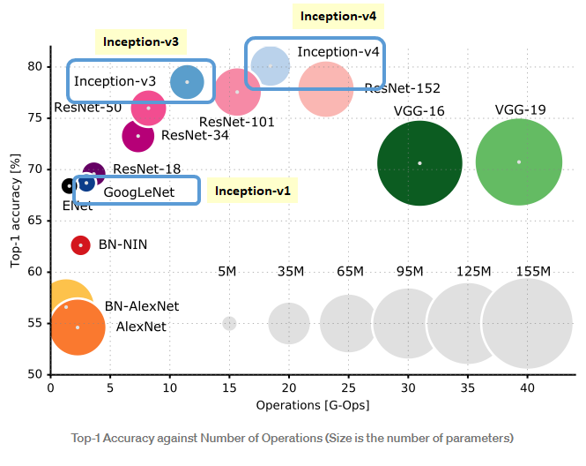
ImageNet

Slide 11
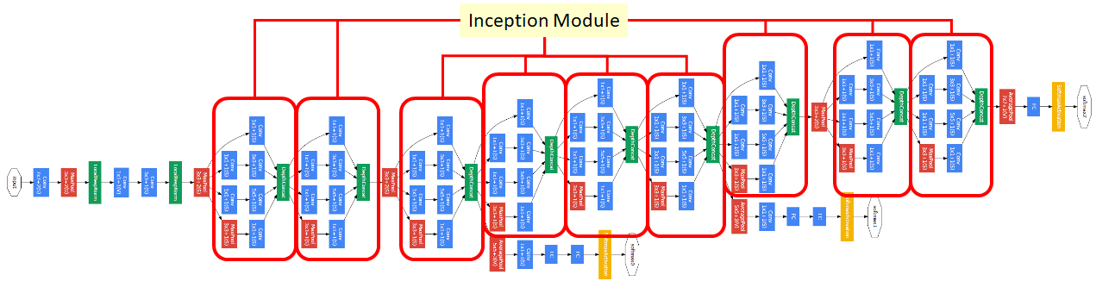
Inception V4

Slide 12
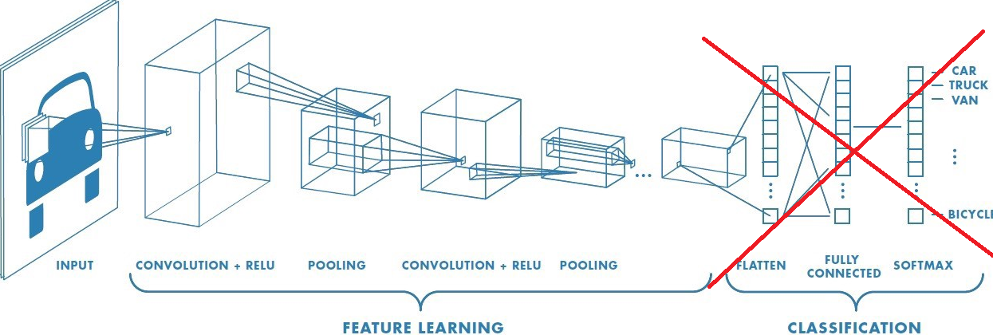
Transfer Learning
Transfer learning is a machine learning method where a model developed for a task is reused as the starting point for a model on a second task.

Slide 13
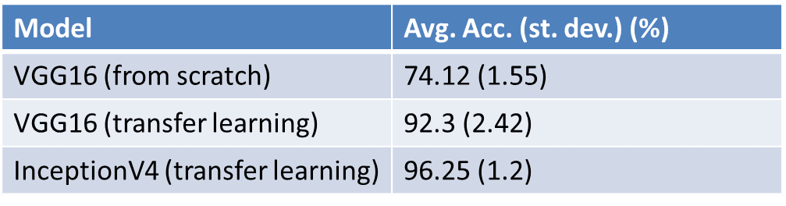
Results
Article Cited 69 times

Slide 14
Now let’s Jump to Jupyter

